Slide 1
The Battle of Neighborhoods
Capstone Project
Daniela Moniz

Slide 2
Introduction
Portugal’s housing market has reached highs over the last years
The main goal of this project is to help those who are looking to buy a house in Lisbon, Portugal
Providing an analysis of the variation of houses’ prices for each parish in Lisbon
Clustering of the parishes into commercial and residential areas.

Slide 3
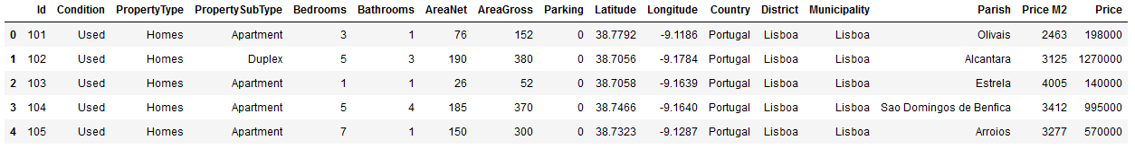
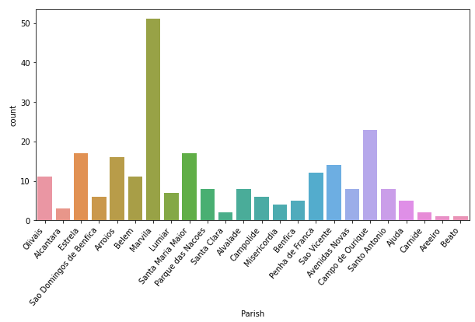
Data
The information of the Portugal’s housing market is based on Kaggle dataset (Lisbon House Prices)
This dataset is then pre-processed and visualized in order to find missing data and outliers:
The number of houses in the data seems to be balanced except for Marvila parish (There are more houses for selling in that area)

Slide 4
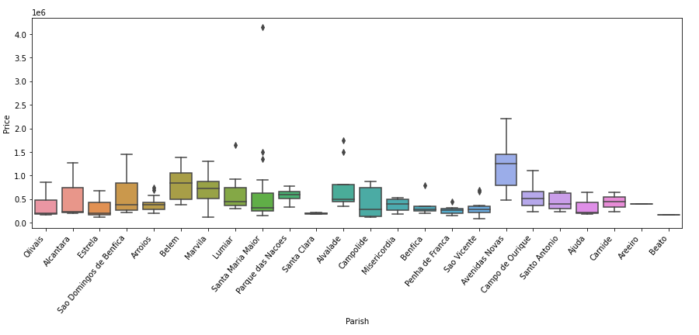
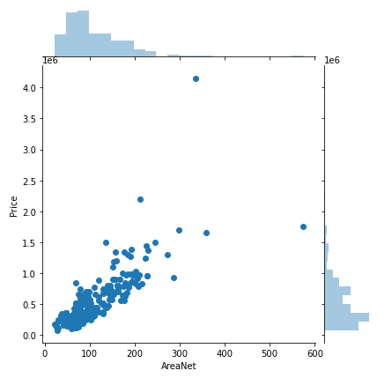
Data
The Avenidas Novas is the parish with the highest houses’ price
Positive correlation between the Area Net in m2 and houses’ price

Slide 5
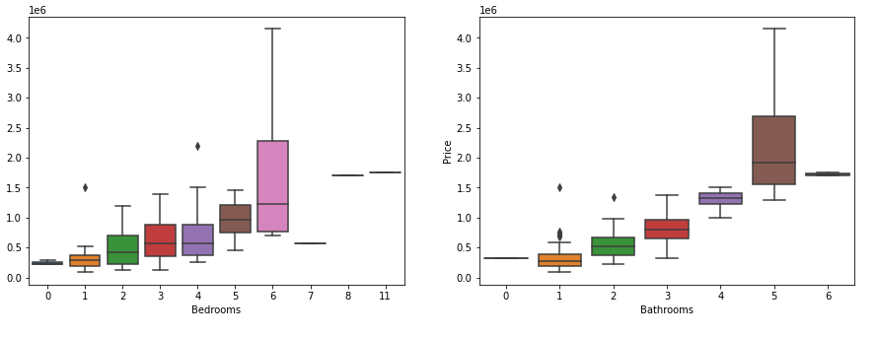
Data
From the results, it can be seen that are at least two important outliers that were removed from the dataset
On average the houses’ prices increase with the number of bathrooms and bedrooms

Slide 6
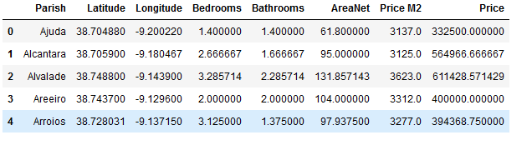
Data
Final dataset utilized where each row represents the average characteristics of the houses for each parish in Lisbon

Slide 7
Methodology
The first step resides in utilizing the Folium to create a map of Lisbon with the main parishes and adding the average prices and area net of the houses in each area
Afterwards, the main venues near each parish are computed via the Foursquare
The k-means algorithm is performed with the aim of dividing the parishes into commercial and residential areas according to the venues nearby
Present a final Lisbon map that beyond the houses’ characteristics also highlights if it is a residential or commercial area

Slide 8
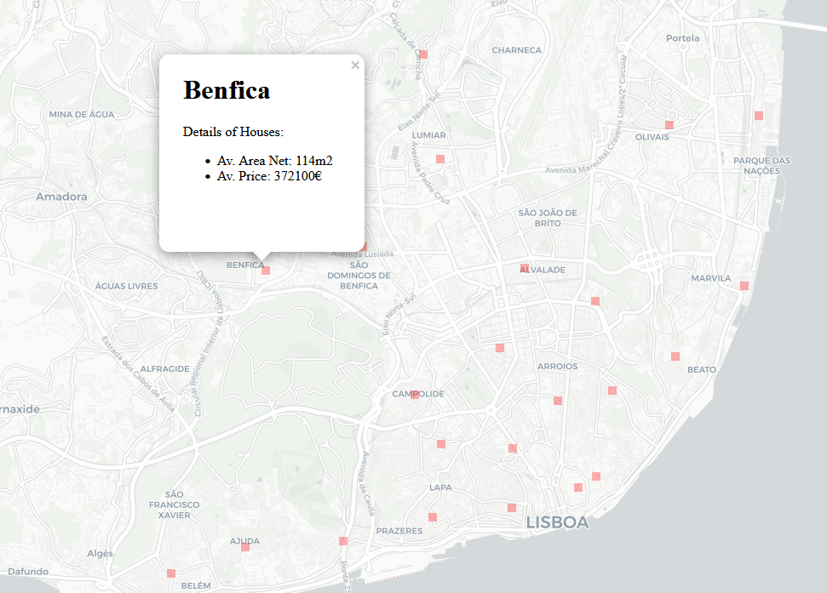
Results
The first result presents the map from Lisbon highlighting the average prices and area net of the houses for each parish in Lisbon

Slide 9
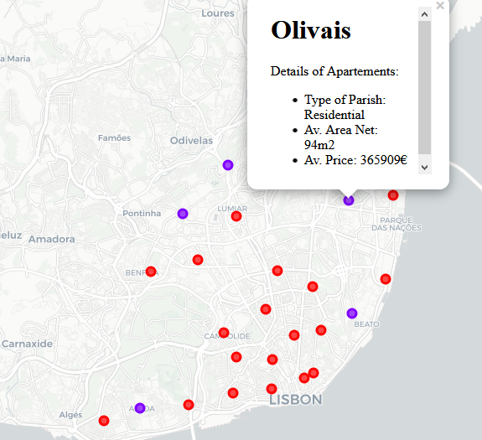
Results
Once the k-means is performed, the map is enhanced with clusters information
Cluster 2 (Purple) is more residential with more supermarkets, gardens and bakeries
Cluster 1 (red) can be considered as more commercial/touristic since the most important venues are hotels and restaurants

Slide 10
Discussion
In this study, it is analyzed the variation of houses’ prices for each parish in Lisbon that could help someone trying to find a house to buy in Lisbon.
It also highlights the most appropriate areas for residential or commercial/touristic purposes based on a clustering algorithm that is performed according to the main venues near each area.

